Slide 1
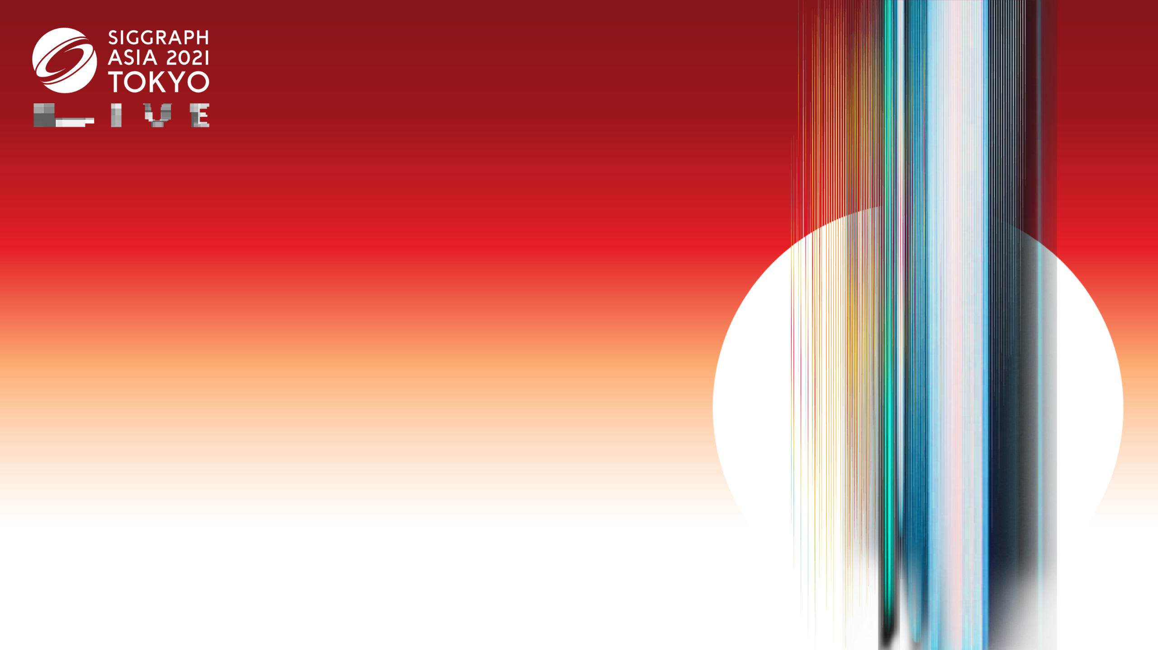

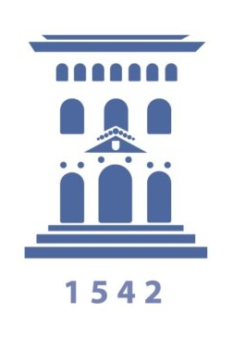
Beyond Mie Theory: Systematic Computation of Bulk Scattering Parameters based on Microphysical Wave Optics
Yu Guo¹ Adrián Jarabo² Shuang Zhao¹
¹University of California, Irvine
²Universidad de Zaragoza, I3A
Notes:
[Final]
Hi everyone, thank you for coming to this talk.
My name is Yu Guo from University of California, Irvine
I am here to present our work in collaboration with University of Zaragoza.
Beyond Mie theory: Systematic computation of bulk scattering parameters based on microphysical wave optics.

Slide 2
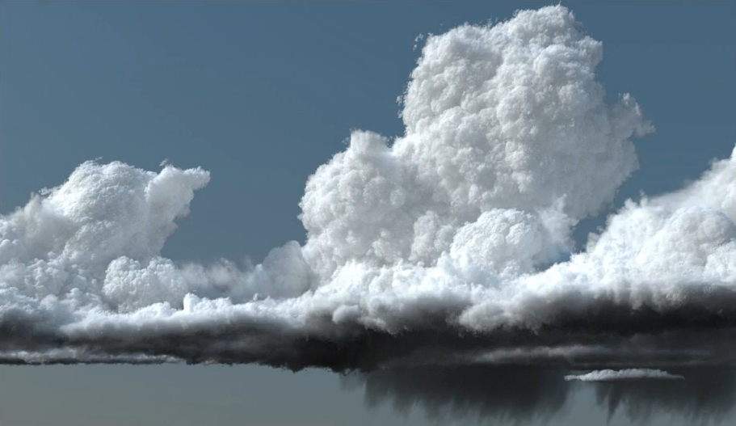
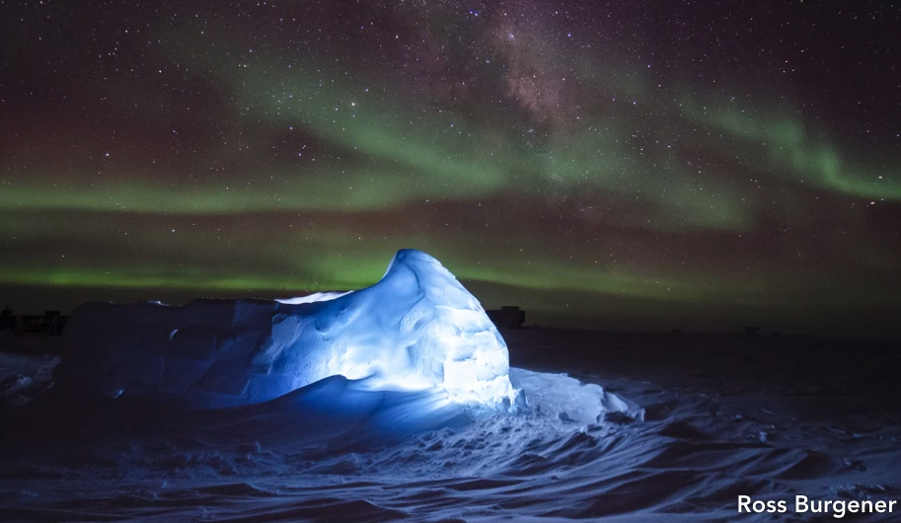

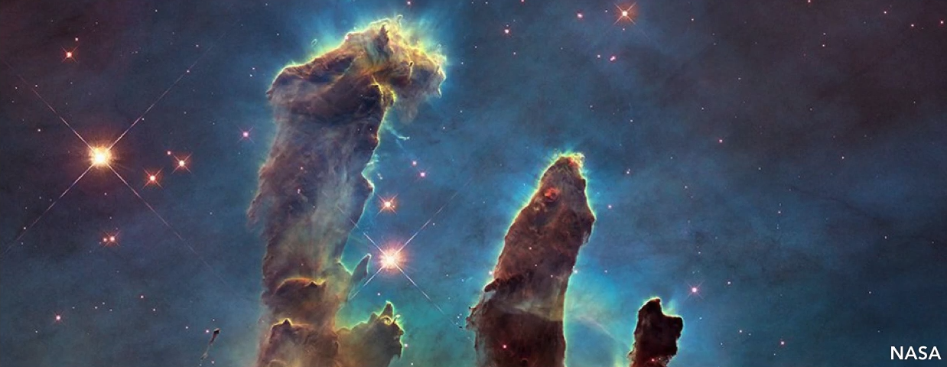
Participating media
Notes:
Participating media are all around us, such as [C] clouds, [C] fog, [C] ice, or even more unusual scene [C] such as nebulae.

Slide 3
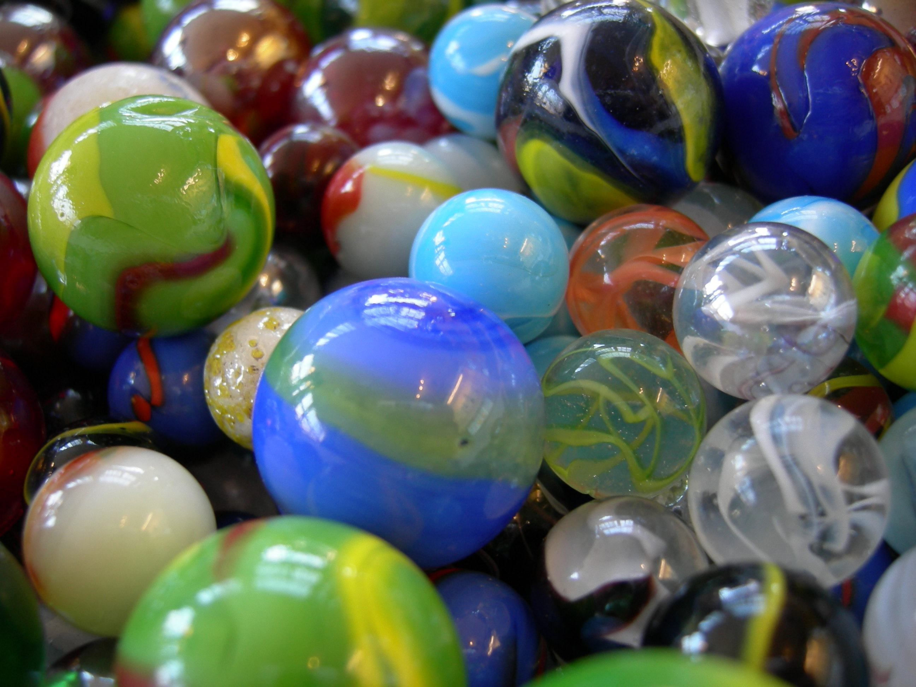
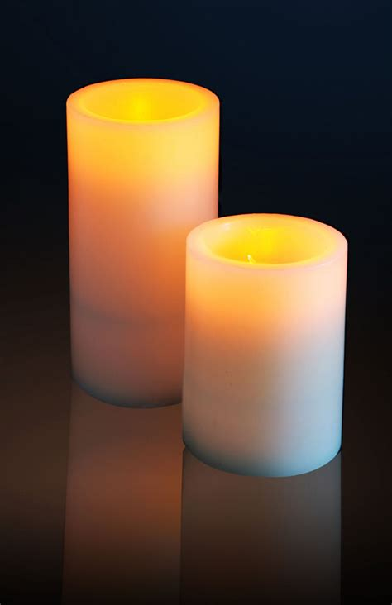
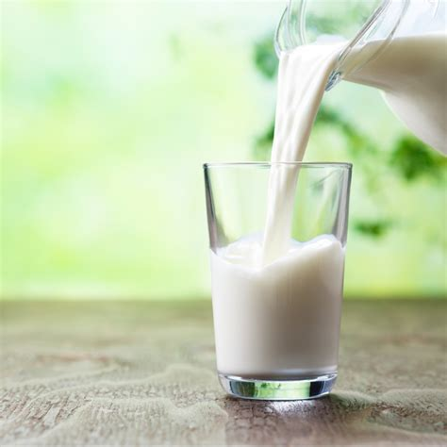
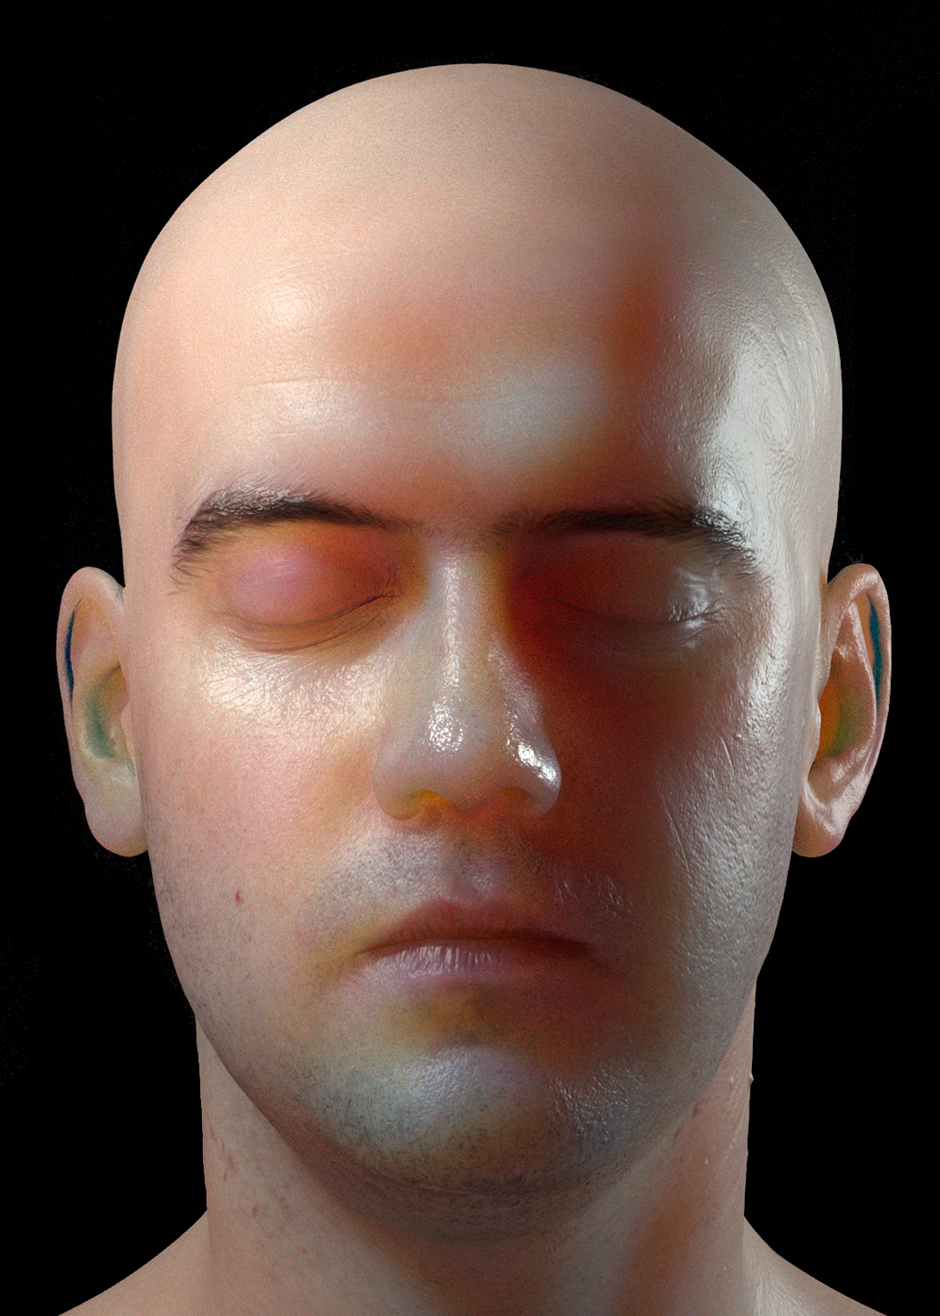
Participating media - translucent materials
Notes:
Also, there are different kinds of translucent materials in our daily life, such as [C] marble, [C] wax, [C] milk and [C] human skin.
[C] These materials allow light to go through their surfaces and scatter in the interior.

Slide 4
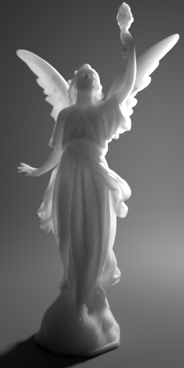
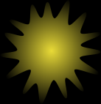

Radiative transfer theory (RTT)
Scattered
Absorbed
Notes:
Light transport in participating media is typically modeled using the radiative transfer theory.
In the RTT, participating media are made of [C] a collection of scattering particles.
Here for simplicity, I am going to show particles in flatland.
[C] As light travels through a participating media, it suffers scattering and absorption events, before it reaches our eyes.

Slide 5
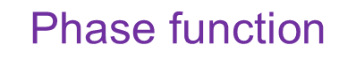

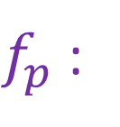
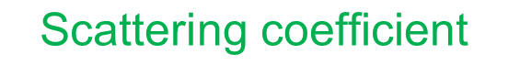
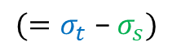
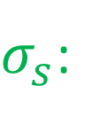
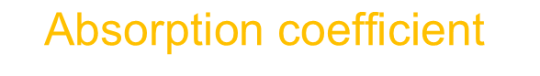
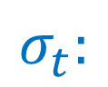
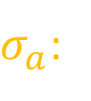
Bulk scattering parameters
$$σ_{t}:$$
$$\text{Extinction} \text{coefficient}$$
$σ_{s}$:
$$\text{Scattering} \text{coefficient}$$
$σ_{a}$:
$$\text{Absorption} \text{coefficient}$$
X
$$(=σ_{t} \text{−} σ_{s})$$
$f_{p}$ :
$$\text{Phase} \text{function}$$
Notes:
RTT characterizes the optical property of a medium using a few parameters.
While light travels, [C] it will go for a random distance before interacting with medium.
[C] The extinction coefficient controls the average of such distance, or “mean free path”.
When it interacts with the medium, it has a chance [C] to be scattered or absorbed.
[C] The scattering and absorption coefficients control how likely this happens.
[C] If the particle is not absorbed, it will be scattered into a random direction.
[C] The phase function controls the distribution of this new direction.

Slide 6
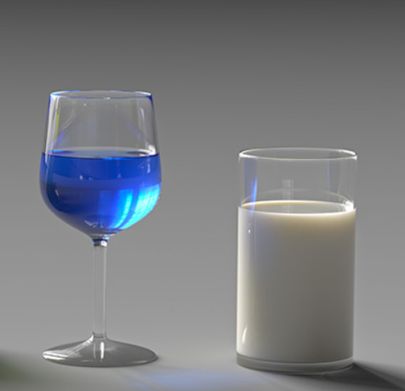
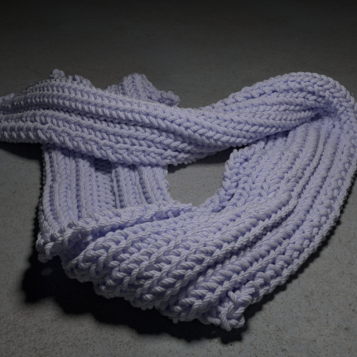
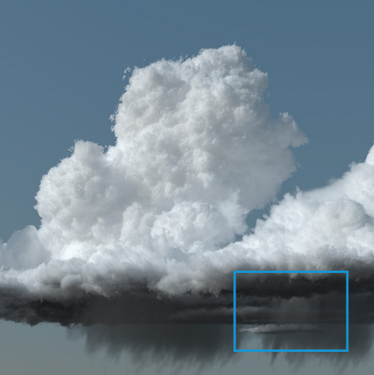
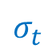
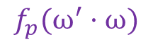
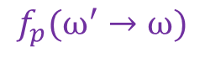
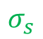
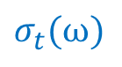
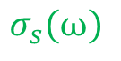
Types of media
Isotropic
Anisotropic
Spatially Correlated
[Jakob 2010]
[Jarabo 2018; Bitterli 2018]
$$σ_{t}$$
$$σ_{s}$$
$$f_{p}(ω^{′}·ω)$$
$$σ_{t}(ω)$$
$$σ_{s}(ω)$$
$$f_{p}(ω^{′}→ω)$$
Notes:
People use different scattering models to describe the optical properties.
[C] The isotropic media assume that each particle has a position completely random and direction independent.
[C] However, the anisotropic media have optical properties with stronger directional dependency compared to isotropic media, such as wood or cloth fiber.
[C] In media with positive correlation, for example, cloud, the particles tend to form clusters. The areas with low concentrations have higher transmittance.

Slide 7
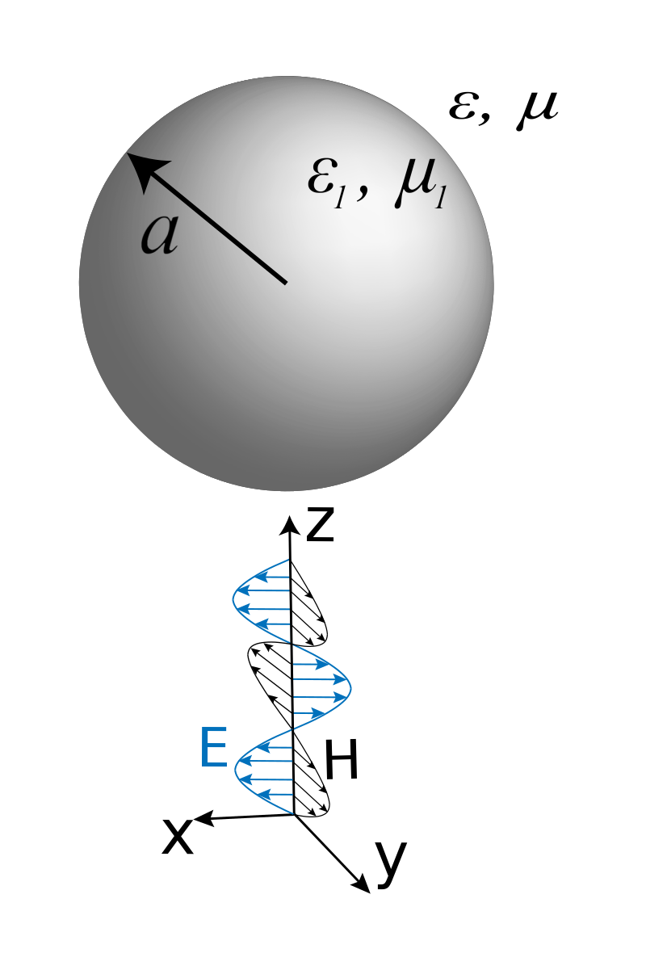
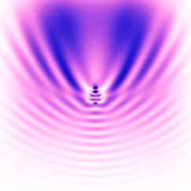
Lorenz-Mie theory
E
H
Electromagnetic plane wave
Scattered field
Notes:
In order to model the bulk scattering parameters, we generally rely on Lorenz-Mie theory.
[C] Considering of the single particle in the medium, the Lorenz-Mie theory rigorously computes [C] the scattered field under an incident electromagnetic plane wave.

Slide 8
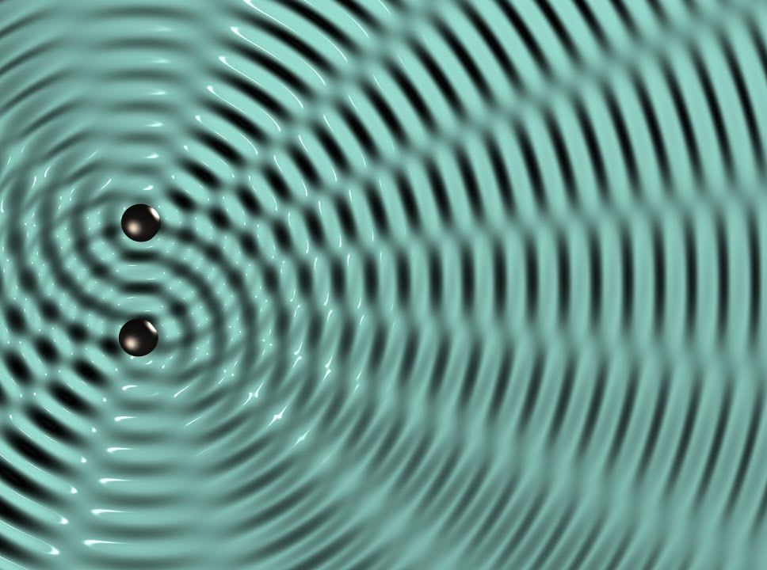
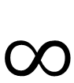
Lorenz-Mie theory
Far-field approximation
Assumption:
Far-field approximation
Independent scattering
$$∞$$
Interference
Notes:
However, the Lorenz-Mie theory relies on the assumption of the far-field approximation and independent scattering.
[C] For any two particles, the distance between them is infinitely large.
[C] Considering the light as a wave, this far-field approximation neglects significant [C] near-field interaction between particles.

Slide 9


Contribution
A computational framework for modeling light scattering beyond Lorenz-Mie theory.
Support wide range of participating media.
Notes:
In the rest of the talk,
We will establish a new computational framework for modeling light scattering beyond Lorenz-Mie theory,
[C] and demonstrate how our technique can be systematically applied to compute scattering parameters for various participating media.

Slide 10
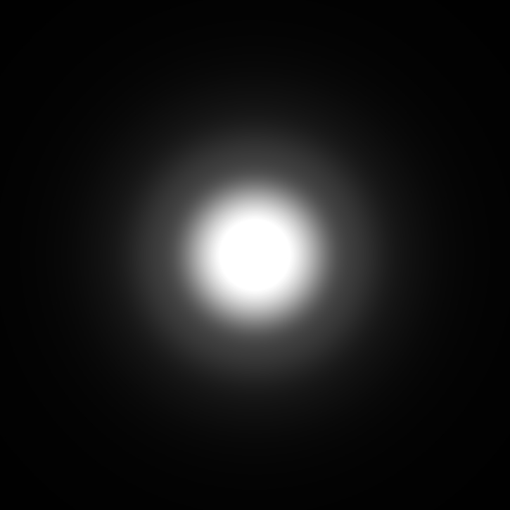
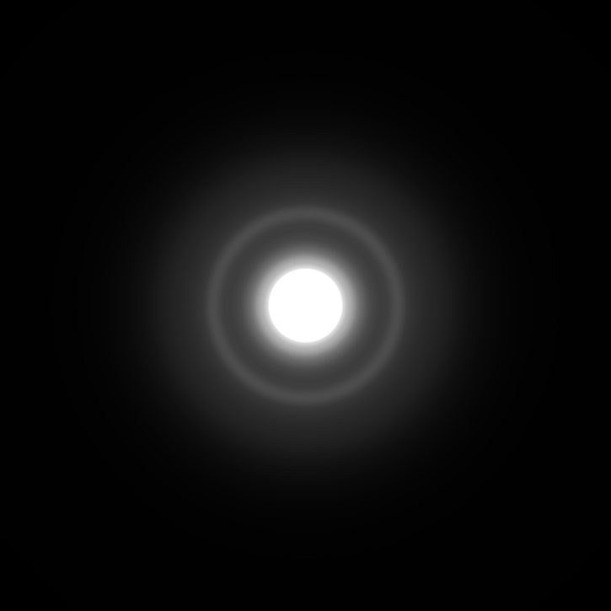
Result preview
Lorenz-Mie:
Ours:
(Far-field assumption)
(Near-field interaction)
Wavelength = 700nm
Particle radius = 300nm
Notes:
For a quick preview, we show renderings of thin slabs lit with small area light from behind.
Result on the left is obtained using a conventional single-particle setting, which only considers the far-field scattering.
For the result on the right, we use identical particle counts per unit volume, but consider the near-field particles interference.
They have very different visual appearances.

Slide 11
Our method
Notes:
Next, I will describe how our method works.

Slide 12
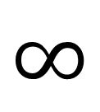
Going beyond far-field
$$∞$$
R
Notes:
[C] To remove the far-field assumption, [C] and consider the interaction among all the particles, we go back to the first principle of light transport, Maxwell electromagnetism.

Slide 13

Going beyond far-field
E
Wave
Simulation
H
Incident wave
Scattered field
Too extensive to solve
Notes:
Given an incident wave and all the particles’ information (including location for each particle), we can do a full-wave simulation by solving Maxwell equations to get the scattered field.
Theoretically speaking, it should work, but in practice, there’re billions of particles in the medium. It is impossible to model them and solve the equations.
[C] We don’t want to handle such an extensive system, but still need microscale wave-optics effects such as diffraction and interference.

Slide 14
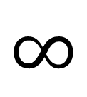
Our method
Far-field approximation between clusters
$$∞$$
Near-field scattering in cluster
:scatterer
:cluster
Notes:
Here’s our solution:
We gather scatterers in different clusters and handle near-field scattering in each cluster [C] but still use far-field approximation between clusters.
In other words, we consider the cluster as a big scatterer. Later we can compute bulk scattering parameters from the cluster.

Slide 15
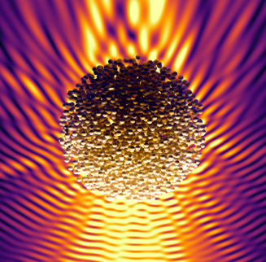
Our method
E
Wave
Simulation
H
CELES
Cluster
(number of particles, distance between particles, particle radius, IOR)
Incident wave
Scattered field
Notes:
To handle the near-field scattering, we did offline wave simulation on the cluster with user-defined particle distribution and arrangement.
Including number of particles in the cluster, the distance between particles, particle radius and index of refraction of the particle.

Slide 16
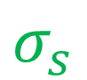
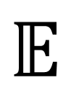
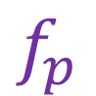
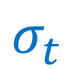
Our method
$$σ_{t}$$
$$𝔼$$
$$σ_{s}$$
$$f_{p}$$
Bulk scattering parameters
Notes:
[Animation]
Then we average the scattered field of several random realizations of the clusters.
[C] After that, we compute the optical properties from the averaged scattered field of the cluster. Please see our paper for the detailed derivation.
After we get the optical properties, It can be readily used in any radiative-based light transport simulator.

Slide 17
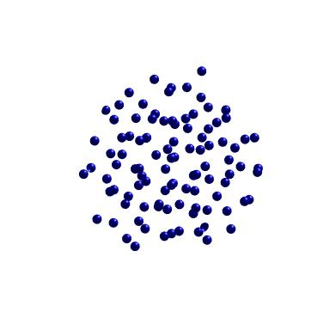
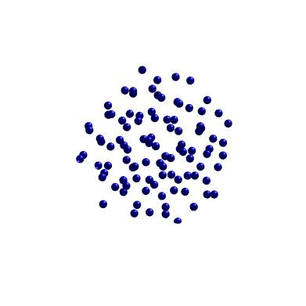
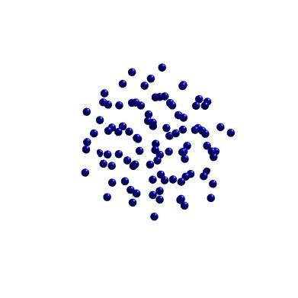
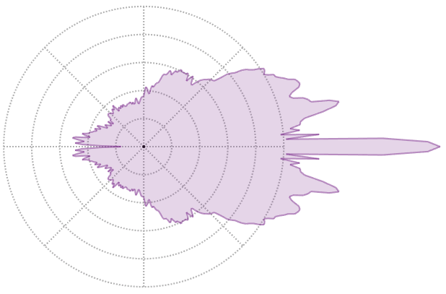
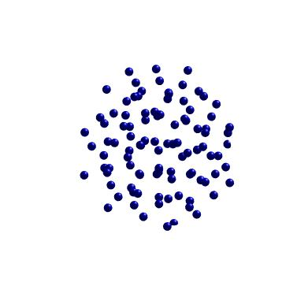
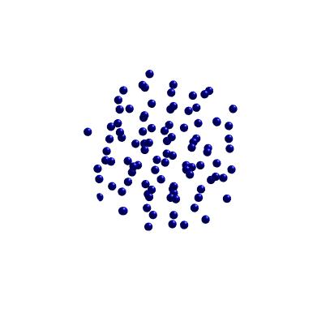
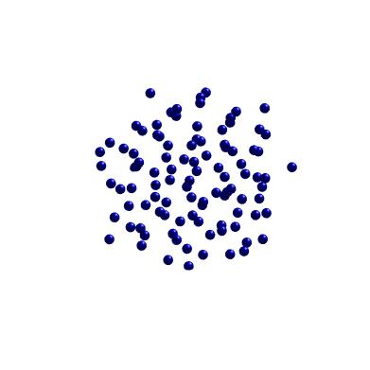
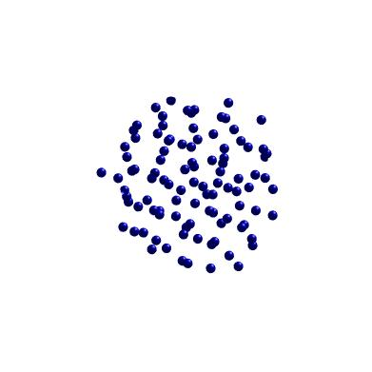
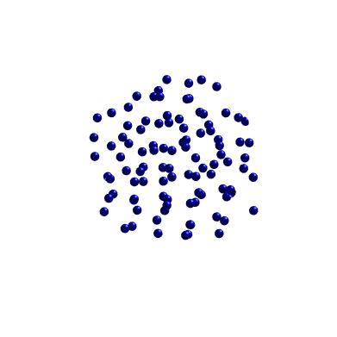



Different realizations
$$𝔼$$
$$f_{p}$$
Notes:
[Animation]
Here we show an example with different realizations of the same media and their averaged correlated phase function.

Slide 18
Validation
Notes:
Next, we first validate our technique by comparing bulk scattering parameters computed with our method and the Lorenz-Mie theory.

Slide 19
Validation
N = 1
Clusters of particles
Independent particle
Notes:
Note that if each cluster only contains one particle, our method reduces to the previous independent scattering method.

Slide 20


Validation
Phase function:
[Wavelength: 600nm]
Particle radius:
300nm
600nm
900nm
Notes:
To verify this, we compared our results with Lorenz-Mie theory,
We focus on the configuration where a cluster contains only one (spherical) particle as this is a fundamental assumption of the Lorenz-Mie theory.
we visualize computed single-scattering phase functions at the wavelength 600 nm with three particle radii (300, 600, and 900 nm).
From left to right, the particle size increase, and our results match those given by the Mie Theory exactly.

Slide 21
Experiments
Notes:
Now we apply our technique to compute bulk scattering parameters for a wide range of participating media.

Slide 22




Isotropic – particle size
Opaque
Notes:
Let’s look at the first experiment. Here we vary particle size and fix all the others.
With 100 uniformly distributed particles, we apply our technique to three particle sizes, 400, 500, and 600 nm.
As shown here, as we increase the particles' radius, the object appears more opaque overall.

Slide 23


Isotropic – cluster capacity
N=20
N=100
N=500
Transmittance
Notes:
For the same medium which the total particles in the medium is kept the same, we increase the number of particles within the cluster, but with fixed particle size, the interference among particles increases the transmittance of this material.

Slide 24


Multi-spectral
Phase function:
700nm
400nm
Thin-slab rendering
Notes:
Since our technique is derived using microphysical wave optics,
It allows generating multi-spectral parameters based on a single configuration of particle cluster.
On the left is the visualization of phase function with picked 5 wavelengths.
The right image is the corresponding multi-spectral renderings of a thin slab lit by a small area light from behind.
As you can see, the smooth changes in scattering parameters across wavelength have resulted in a characteristic rainbow-like effect.

Slide 25




Anisotropic
z
y
x
y
x
x
y
Notes:
Our method can support any kind of particle distribution.
In this example, particles follow an anisotropic Gaussian distribution, as illustrated in the left image.
We use tabulated optical parameters since they are all directionally dependent.
As a result, different medium orientations will have very different looking.

Slide 26




Spatially correlated
Positively correlated:
Negatively correlated:
Notes:
Next, we compare the effect of introducing microscopic correlation in the cluster, but the clusters are uniformly distributed in the medium.
Different correlations have a significant effect on the final appearance of the translucent materials.

Slide 27




Summary
New framework
Type of media
$$∞$$
Notes:
To summarize,
we introduce a new technique to compute bulk scattering parameters for participating media.
Our technique models a translucent material as clusters of particles distributed in embedding media.
[C] We modeled a wide range of participating media by modifying the arrangement of particles within each cluster, including isotropic, anisotropic, and spatially correlated media.

Slide 28



Limitations & future works
More general
More efficient
Model Fitting
$$∞?$$
$$≈?$$
Notes:
While considering the effect of the near-field on clusters, our work is still based on the RTT.
We cannot accurately model the scattering in the intermediate region, which we treat as the far-field.
A more accurate representation would further enhance the generality of our theory.
[C] Our current implementation requires precomputing the bulk scattering parameters of the media by solving Maxwell equations.
It is pretty expensive with a large number of particles and large particle size.
Finding faster approximations for our scattering functions is interesting future research.
[C] And to extend our theoretical work to fitting real-world measurements, we need efficient inverse fitting techniques.

Slide 29

Thank you!
Beyond Mie Theory: Systematic Computation of Bulk Scattering Parameters based on Microphysical Wave Optics
Yu Guo¹ Adrián Jarabo² Shuang Zhao¹
¹University of California, Irvine ²Universidad de Zaragoza, I3A
Acknowledgements:
Anonymous reviewers
Grants
NSF 1813553
ERC 682080, 956585
Spanish Ministry of Science and Innovation
(PID2019-105004GBI00)
Project page
Notes:
Please see our paper for more details. Thank you for your attention.

Slide 30
Beyond Mie Theory: Systematic Computation of Bulk Scattering Parameters based on Microphysical Wave Optics
Yu Guo¹ Adrián Jarabo² Shuang Zhao¹
¹University of California, Irvine ²Universidad de Zaragoza, I3A
Notes:
Hi everyone, thank you for coming to this talk.
Today I will talk about the generalization of Mie theory with microphysical wave optics.

Slide 31




Our method
$$σ_{s}$$
Wave
Simulation
$$σ_{t}$$
$$𝔼$$
CELES
$$f_{p}$$
Cluster
(number of particles, distance between particles, particle radius, IOR)
Bulk scattering parameters
Incident field
Scattered field
Notes:
To handle the near-field scattering, we did offline wave simulation on the cluster with user-defined particle distribution and arrangement.
[C] Then we average the scattered field of several random realizations of the clusters.
[C] After that, we compute the optical properties from the averaged scattered field of the cluster. Please see our paper for the detailed derivation.
After we get the optical properties, It can be readily used in any radiative-based light transport simulator.

Slide 32

Anisotropic
z
y
x
y
x
x
y
Notes:
Our method can support any kinds of particle distribution.
In this example. particles following an anisotropic Gaussian distribution as illustrated in the left image.
We use tabulated optical parameters since they are all directionally dependent,
As results, different medium’s orientation will have a very different looking.

Slide 33


Spatially correlated
Positively correlated:
Negatively correlated:
Notes:
Next, we compare the effect of introducing microscopic correlation in the cluster, but the clusters is uniformly distributed in the medium.
Different correlations have significant effect on the final appearance of the translucent materials.

Slide 34

Electromagnetic radiation
Scatterer type
Method
Maxwell Equation
Single Sphere
Lorenz-Mie theory
Multiple
Non-sphere
Numerical methods
Notes:
, which is solving Maxwell equations.
Lorenz-Mie theory provides closed-from solutions for single sphere particle,

Slide 35



Volumatic rendering
Radiative Transfer Equation (RTE)
Optical properties
Notes:
If we look at these media closely, they are made of a collection of scattering particles embedding in some surrounding material.
Here for simplicity, I am going to show particles in flatland.
[C] After entering a translucent material, light travels in straight lines in the embedding medium and occasionally collides with a particle and gets redirected into a new direction.
[C] To render the medium, it is common to compute the light transport by solving the radiative transfer equation.
This equation describes [C] the local change of radiance in a certain direction as a sum of terms.
[C] The first term decribes the in-scattering from other directions, which is an integral over the sphere.
[C] The next one accounts for the decrease in radiance through extinction, which corresponds to light that is either scattered or absorbed.
[C] Last one, the radiance might also increase because the medium itself is an emitter.
[C] In RTE, we only use optical properties to describ the statistics of the particles. Such as extinction coeficiente sigma_t, absorption coeficiente sigma_a, scattering coeficiente sigma_s, and phase function fp
We don’t need to know any information of individual particle.

